Slide 1

Project Proposal
Personal Savings Coach
An AI-Powered Chatbot for Financial Awareness & Budget Tracking
Team Lead: Peter Mburu | Chuka University

Slide 2


The Financial Literacy Gap
A Critical Challenge
Across African communities, particularly among students and young adults, financial discipline is a major hurdle. 45.5% of the financially excluded population are rural youth.
Key Barriers
Most young people do not track expenses due to:
•
Complex, intimidating banking tools.
•
Lack of accessible financial education (42% literacy rate).
•
Absence of simple, mobile-first recording methods.

Slide 3

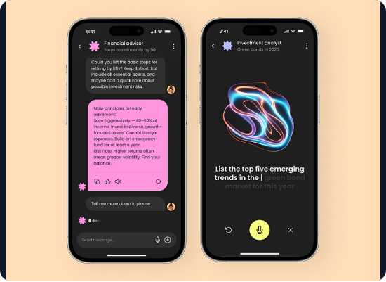
Meet Your AI Coach
Simple. Conversational. Smart.
The Personal Savings Coach is a chatbot web application designed to make finance friendly. It eliminates spreadsheets and complex forms.
Track Spending: Just chat naturally ("I spent 500 KES on lunch").
Analyze Data: Get instant weekly or monthly summaries.
Smart Advice: Receive personalized saving tips powered by Google Vertex AI.

Slide 4






Core Objectives
Intuitive Interface
AI Intelligence
Data Persistence
Develop a clean, accessible Next.js web application with a conversational UI that feels like chatting with a friend.
Integrate Vertex AI & Genkit to understand natural language intents and generate actionable financial advice.
Utilize Firebase Firestore to securely store user expense logs and generate real-time summaries.

Slide 5



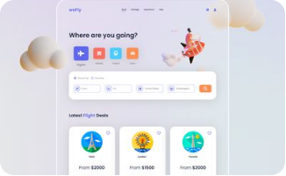


Technical Architecture
Frontend
AI Engine
Backend
React 18 + Vite + Tailwind
Google Vertex AI + Genkit
Firebase Firestore
Fast, responsive UI with accessible primitives.
Conversational flows and RAG-based advice.
Real-time NoSQL database for scalable storage.

Slide 6
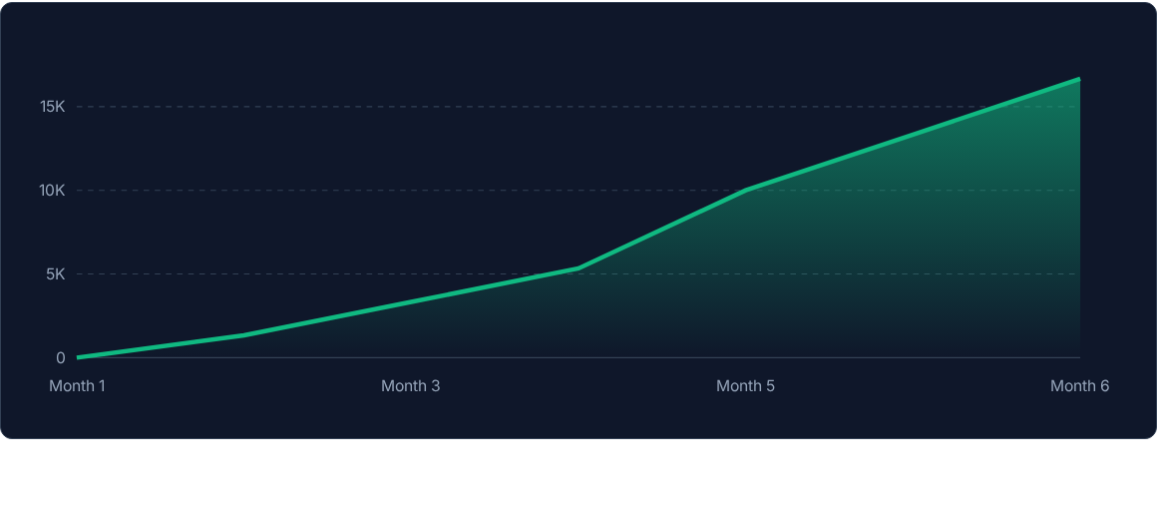
Expected Outcomes: User Savings Growth
Simulation: Users actively using the "Savings Coach" increase savings by 30% over 6 months through better awareness and tracking.

Slide 7

Impact & Scalability
Social Impact
The project drives financial inclusion by making advice accessible. It localizes finance (using Kenyan Shillings) and builds a saving culture.
Sustainability
Serverless: Hosted on Vercel/Cloud Run for low maintenance.
Scalable: Vertex AI handles thousands of concurrent users.
Future: Integration with M-Pesa APIs for auto-tracking.

Slide 8
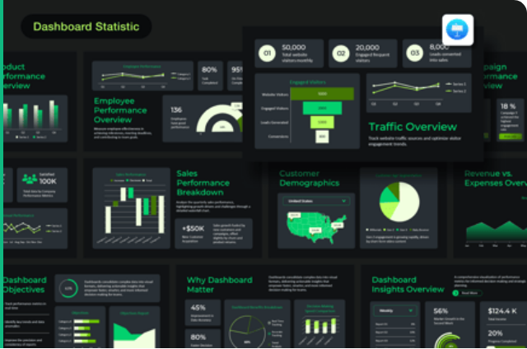
Future Roadmap
Phase 1: Deployment
Launch MVP with basic tracking and Vertex AI advice on Vercel.
Phase 2: Community
Adapt tool for SACCOs and University student groups to teach literacy.
Phase 3: Integration
Direct integration with mobile money (M-Pesa) and bank APIs for automated expense ingestion.

Slide 9


The Team
Peter Mburu
Full-Stack Developer / Project Lead
Chuka University
Expertise:
react & React Ecosystem
Firebase & Cloud Architecture
Node js

Slide 10
Questions?
Personal Savings Coach Project
github.com/petermburu/savings-coach
peter.mburu@chuka.ac.ke

